Slide 1
User Stories
1

Slide 2
What problem do stories address?
Software requirements is a communication problem
Those who want the software must communicate with those who will build it

Slide 3
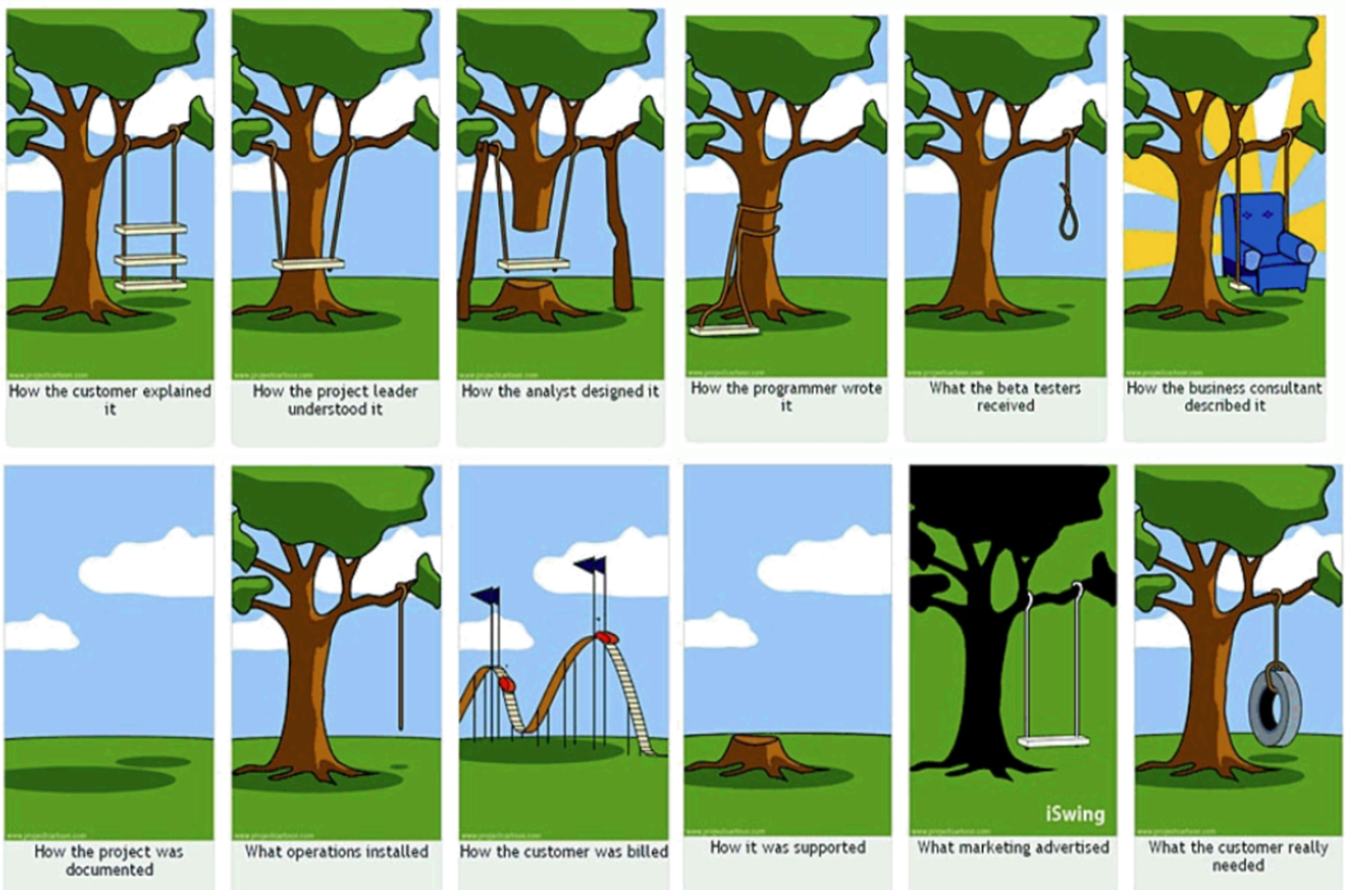
What problem do stories address?

Slide 4
Balance is critical
If either side dominates, the business loses
If the business side dominates…
…functionality and dates are mandated with little regard for reality or whether the developers understand the requirements
If the developers dominate…
…technical jargon replaces the language of the business and developers lose the opportunity to learn from listening

Slide 5
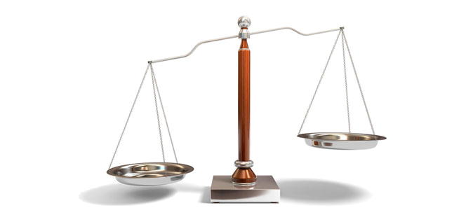
Resource allocation
We need a way of working together so that resource allocation becomes a shared problem
Project fails when the problem of resource allocation falls to far to one side

Slide 6
Responsibility for resource allocation
May trade quality for additional features
May only partially implement a feature
May solely make decisions that should involve the business
If developers are responsible…
Lengthy upfront requirements negotiation and signoff
Features are progressively dropped as the deadline nears
If the business is responsible…

Slide 7
Imperfect schedules
We cannot perfectly predict a software schedule
As users see the software, they come up with new ideas
Too many intangibles
Developers have a notoriously hard time estimating
If we can’t perfectly predict a schedule, we can’t perfectly say what will be delivered

Slide 8
So what do we do?
We make decisions based upon the information we have
…but do it often
Rather than making one all-encompassing set of decisions
This is where user stories come in
…we spread decision-making across the project

Slide 9
Agenda
What stories are
Writing user stories
Why user stories

Slide 10
Three Cs
Details behind the story come out during conversations with the product owner
Conversation
Stories are traditionally written on note cards
Cards may be annotated with estimates, notes, etc.
Card
Acceptance tests confirm a story was coded correctly
Confirmation

Slide 11
Samples from a travel website
As a vacation traveler, I want to see photos of the hotels.
As a user, I want to reserve a hotel room.
As a frequent flyer, I want to rebook a past trip so that I save time booking trips I take often.
As a user, I want to cancel a reservation.

Slide 12
Where are the details?
As a user, I can cancel a reservation.
Does the user get a full or partial refund?
Is the refund to her credit card or is it site credit?
How far ahead must the reservation be cancelled?
Is that the same for all hotels?
For all site visitors? Can frequent travelers cancel later?
Is a confirmation provided to the user?
How?

Slide 13
Details as conditions of satisfaction
As a user, I can cancel a reservation.
Verify that a premium member can cancel the same day without a fee.
Verify that a non-premium member is charged 10% for a same day cancellation.
Verify that an email confirmation is sent.
Verify that the hotel is notified of any cancellation.
The product owner’s conditions of satisfaction can be added to a story
These are essentially tests

Slide 14
Details as conditions of satisfaction
As a premium site member, I can cancel a reservation up to the last minute
As a user, I can cancel a reservation.
As a non-premium member, I can cancel up to 24 hours in advance
As a site visitor, I am emailed a confirmation of any cancelled reservation

Slide 15
Techniques can be combined
These approaches are not mutually exclusive
Write stories at an appropriate level
By the time it’s implemented, each story will have conditions of satisfaction associated with it

Slide 16
The product backlog iceberg
High
Priority
Modeled in greater detail
Modeled in lesser detail
Low
Priority

Slide 17
Some additional useful terms
Theme
A collection of related user stories
Epic
A large user story

Slide 18
An example
As a VP of Marketing, I want to select the timeframe to use when reviewing the performance of past promotional campaigns, so that…
As a VP of Marketing, I want to review the performance of historical promotional campaigns so that I can identify and repeat profitable ones.
Epics???
As a VP of Marketing, I can select which type of campaigns (direct mail, TV, email, radio, etc.) to include when reviewing the performance of past …
Clearly an epic

Slide 19
As a VP of Marketing, I want to see information on direct mailings when reviewing historical campaigns.
As a VP of Marketing, I want to see information on TV ads when reviewing historical campaigns.
As a VP of Marketing, I want to see information on email ads when reviewing historical campaigns.

Slide 20
Agenda
What stories are
Writing user stories
Why user stories

Slide 21
Logging in
See how many user stories you can write about logging in.
Examples:
As a registered user, I am required to log in so that I can access the system.
As a forgetful user, I can request a password reminder so that I can log in if I forget mine.
“As a <user role>, I <want/need/can/etc> <goal> so that <reason>.”

Slide 22
Story-writing workshops
Includes whole team plus possibly some external stakeholders
Typically not done every sprint
Brainstorm to generate stories
Goal is to write as many stories as possible
Some will be “implementation ready”
Others will be epics
No prioritization at this point

Slide 23
Story-writing workshops
As a frequent flyer, I want to book a trip using miles.
As a frequent flyer, I want to check my account.
As a frequent flyer, I want to rebook a trip I take often.
Frequent Flyer
As a frequent flyer, I want to book a trip.
As a frequent flyer, I want to request an upgrade.
As a frequent flyer, I want to …
As a frequent flyer, I want to see if my upgrade cleared.

Slide 24
Agenda
What stories are
Writing user stories
Why user stories

Slide 25
So why user stories?
Shift focus from writing to talking
If requirements are written down
then
The user will get what she wants
At best she’ll get what was written
“You built what I asked for, but it’s not what I need.”

Slide 26
Words are imprecise
Entrée comes with soup or salad and bread.
Which is right?
(Soup or Salad) and Bread
(Soup) or (Salad and Bread)

Slide 27
Examples
Must the user enter a name?
Can it be other than 127 characters?
Are there invalid characters?
The user can enter a name. It can be 127 characters.
The system should prominently display a warning message whenever the user enters invalid data..
What does should mean?
What does prominently display mean?
Is invalid data defined elsewhere?

Slide 28
Additional reasons
Stories are understandable
Developers and customers understand them
People are better able to remember events if they are organized into stories
Support and encourage iterative development
Can easily start with epics and disaggregate closer to development time

Slide 29
Yet more reasons
Stories are the right size for planning
Stories support opportunistic development
We design solutions by moving opportunistically between top-down and bottom-up approaches
Stories support participatory design

Slide 30
Most importantly
Don’t forget the purpose
The story text we write on cards is less important than the conversations we have.

Slide 31
INVEST
Independent – The story stands alone. Stories that are highly dependent on each other are hard to prioritize and hard to estimate. Problems with dependencies can be solved by dividing stories differently, or combining several small stories into a single larger one.
Negotiable – Remember Card-Conversation-Confirmation? A story should be a starting point for a conversation and an opening for the team to suggest a solution, not a detailed description of how the Product Owner expects that feature or piece of functionality to be implemented.
Valuable – It’s all about the end-user. If you can’t describe the value a customer is going to get out of your story, it’s not a good story.
Estimable – No estimate, no entry into the Sprint backlog. If there’s not enough information or definition to allow the team to put an estimate on a story, it doesn’t get started.
Small – A story shouldn’t take longer than a single Sprint to finish. Any larger than this and it’s hard to estimate or plan for it. It’s also likely to be hard to write acceptance criteria and to test.
Testable – If you can’t test it, how do you know when a story is done and working as it should.

Slide 32
?

Slide 33
References
Cohn, Mike. “User Stories for Agile Requirements”

